Slide 1
Topic : Number Theory

Slide 2
Groups, Rings and Fields
A group is a set, G, together with an operation • (called the group law of G) that combines any two elements a and b to form another element, denoted a • b or ab. To qualify as a group, the set and operation, (G, •), must satisfy four requirements known as the group axioms:
Closure: For all a, b in G, the result of operation a•b, is also in G.
Associativity: For all a, b and c in G (a •b) •c= a • (b • c).
Identity element: There exists an element e in G, such that for every element a in G, the equation e • a = a • e = a holds. Such an element is unique.
Inverse element: For each a in G, there exists an element b in G, commonly denoted a⁻¹ , such that a • b = b • a = e, where e is the identity element.

Slide 3
Example
Is (Z,+) a group?
Solution
One of the most familiar groups is the set of integers Z which consists of the numbers ..., −4, −3, −2, −1, 0, 1, 2, 3, 4, ..., together with addition.
For any two integers a and b, the sum a + b is also an integer. That is, addition of integers always yields an integer. This property is known as closure under addition.
For all integers a, b and c, (a + b) + c = a + (b + c). Expressed in words, adding a to b first, and then adding the result to c gives the same final result as adding a to the sum of b and c, a property known as associativity

Slide 4
Solution-Continue
If a is any integer, then 0 + a = a + 0 = a. Zero is called the identity element of addition because adding it to any integer returns the same integer.
For every integer a, there is an integer b such that a + b = b + a = 0. The integer b is called the inverse element of the integer a and is denoted −a.

Slide 5
Example
Is (N,+) a group? (Is the set of Natural numbers a group under addition?)
Solution
This group is the set of natural numbers N which consists of the numbers 0, 1, 2, 3, ..., together with addition.
For any two integers a and b, the sum a + b is also an integer. That is, addition of integers always yields an integer. This property is known as closure under addition.
For all integers a, b and c, (a + b) + c = a + (b + c). Expressed in words, adding a to b first, and then adding the result to c gives the same final result as adding a to the sum of b and c, a property known as associativity

Slide 6
Solution-Continue
If a is any integer, then 0 + a = a + 0 = a. Zero is called the identity element of addition because adding it to any integer returns the same integer.
Inverse does not exist for all natural numbers (in fact, 0 is the only natural number with an inverse ) For example, there is no natural numbers x satisfying x+1=0.
So the natural numbers does not form a group under addition.

Slide 7
Example
Do real numbers make groups under multiplication or not?
Solution
The set of real numbers is not a group under multiplication because the element 0 has no inverse in that group, as division by 0 does not make any sense. However, if you remove 0 from the set of real numbers then the resulting set will be a group with respect to multiplication.

Slide 8
Finite group and infinite group
If a group has a finite number of elements, it is referred to as a finite group, and the order of the group is equal to the number of elements in the group. Otherwise, the group is infinite group.
Abelian group
A group is said to be abelian if it satisfies the following additional condition:
Commutative: a•b=b•a for all a, b in G.
The set of integers under addition is an abelian group.

Slide 9
Rings
A ring is a set R equipped with two binary operations + and · (Multiplication) satisfying the following three sets of axioms, called the ring axioms
R is an abelian group under addition, meaning that:
For any two integers a and b, the sum a + b is also an integer
(a + b) + c = a + (b + c) for all a, b, c in R (+ is associative).
a + b = b + a for all a, b in R (+ is commutative).
There is an element 0 in R such that a + 0 = a for all a in R (0 is the additive identity).
For each a in R there exists −a in R such that a + (−a) = 0 (−a is the additive inverse of a).

Slide 10
Rings-Continue
R is a monoid under multiplication, meaning that:
Given two integers a and b, their product, a · b is also an integer. (Closure axiom for multiplication)
(a · b) · c = a · (b · c) for all a, b, c in R (· is associative).
There is an element 1 in R such that a · 1 = a and 1 · a = a for all a in R (1 is the multiplicative identity).
Multiplication is distributive with respect to addition:
a ⋅ (b + c) = (a · b) + (a · c) for all a, b, c in R (left distributivity).
(b + c) · a = (b · a) + (c · a) for all a, b, c in R (right distributivity).

Slide 11
Example of Ring
The most familiar example of a ring is the set of all integers, Z, consisting of the numbers ..., −4, −3, −2, −1, 0, 1, 2, 3, 4, ... together with the usual operations of addition and multiplication.
The integers form an abelian group under addition; that is:
Closure axiom for addition: Given two integers a and b, their sum, a + b is also an integer.
Associativity of addition: For any integers, a, b and c, (a + b) + c = a + (b + c). So, adding b to a, and then adding c to this result, is the same as adding c to b, and then adding this result to a.
Existence of additive identity: For any integer a, a + 0 = 0 + a = a. Zero is called the identity element of the integers because adding 0 to any integer (in any order) returns the same integer.

Slide 12
Example of Ring-continue
• Existence of additive inverse: For any integer a, there exists an integer denoted by −a such that a + (−a) = (−a) + a = 0. The element, −a, is called the additive inverse of a because adding a to −a (in any order) returns the identity.
• Commutativity of addition: For any two integers a and b, a + b = b + a. So the order in which two integers are added is irrelevant

Slide 13
Example of Ring-continue
The integers form a multiplicative monoid (a monoid under multiplication); that is:
• Closure axiom for multiplication: Given two integers a and b, their product, a · b is also an integer.
• Associativity of multiplication: Given any integers, a, b and c, (a · b) · c = a · (b · c). So multiplying b with a, and then multiplying c to this result, is the same as multiplying c with b, and then multiplying a to this result.
• Existence of multiplicative identity: For any integer a, a · 1 = 1 · a = a. So multiplying any integer with 1 (in any order) gives back that integer. One is therefore called the multiplicative identity.

Slide 14
Example of Ring-continue
Multiplication is distributive over addition : These two structures on the integers (addition and multiplication) are compatible in the sense that
• a · (b + c) = (a · b) + (a · c), and
• (a + b) · c = (a · c) + (b · c) for any three integers a, b and c.
Another familiar example is the set of real numbers R, equipped with the usual addition and multiplication.

Slide 15
Field
A field is a set F that is a commutative group with respect to two compatible operations, addition and multiplication (the latter excluding zero), with "compatible" being formalized by distributivity, and the requirement that the additive and the multiplicative identities are distinct (0 ≠ 1).
The most common way to formalize this is by defining a field as a set together with two operations, usually called addition and multiplication, and denoted by + and ·, respectively, such that the following axioms hold
Closure of F under addition and multiplication
  For all a, b in F, both a + b and a · b are in F

Slide 16
Field-Continue
Associativity of addition and multiplication
  For all a, b, and c in F, the following equalities hold:
  a + (b + c) = (a + b) + c and a · (b · c) = (a · b) · c
Commutativity of addition and multiplication
  For all a and b in F, the following equalities hold: a + b = b + a and a · b = b · a.
Existence of additive and multiplicative identity elements
  There exists an element of F, called the additive identity element and denoted by 0, such that for all a in F, a + 0 = a. Likewise, there is an element, called the multiplicative identity element and denoted by 1, such that for all a in F, a · 1 = a. The additive identity and the multiplicative identity are required to be distinct.

Slide 17
Field-Continue
Existence of additive inverses and multiplicative inverses
  For every a in F, there exists an element −a in F, such that a + (−a) = 0. Similarly, for any a in F other than 0, there exists an element a⁻¹ in F, such that a · a⁻¹ = 1.
Distributivity of multiplication over addition
  For all a, b and c in F, the following equality holds:
  a · (b + c) = (a · b) + (a · c).

Slide 18
Example
The rational numbers Q, the real numbers R and the complex numbers C are examples of fields.
The set Z of integers is not a field. It does not satisfy the multiplicative inverse axiom,
“For any a in Z other than 0, there exists an element a⁻¹ in Z, such that a · a⁻¹ = 1.”
Beacuse, the only nonzero integers that have multiplicative inverses that are integers are 1 and −1. For example, 2 is a nonzero integer. If 2 had a multiplicative inverse in Z, there would be an integer n such that 2n = 1, which is impossible, since 1 is an odd integer, and not an even integer.

Slide 19
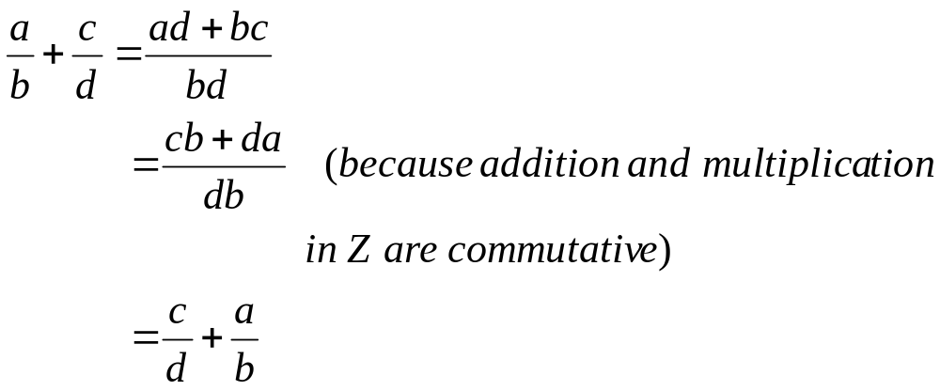
Example
A simple example of a field is the field of rational numbers, consisting of numbers which can be written as fractions a/b, where a and b are integers, and b ≠ 0.
We will prove that some of the field axioms are true for . The others are left as exercises. Suppose a/b and c/d are in Q.
Addition is commutative

Slide 20
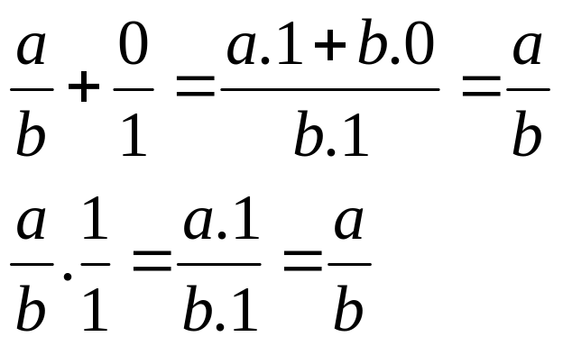

Continue
Existence of additive and multiplicative identity elements
0/1 and 1/1 are the identity elements for addition and multiplication.
Existence of additive inverses and multiplicative inverses
The additive inverse of such a fraction is simply −a/b, and the multiplicative inverse (provided that a ≠ 0) is b/a.

Slide 21
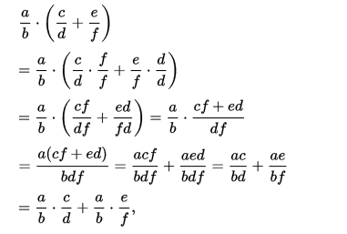
Example-Continue
  Let us consider the axiom “Distributivity of multiplication over addition”
  For all a, b and c in F, the following equality holds:
  a · (b + c) = (a · b) + (a · c).

Slide 22
End

